Slide 1
Marketing Analytics
Segmentation and Marketing
Professor Özgür Özlük

Slide 2
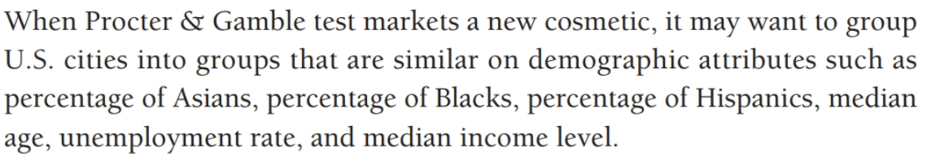
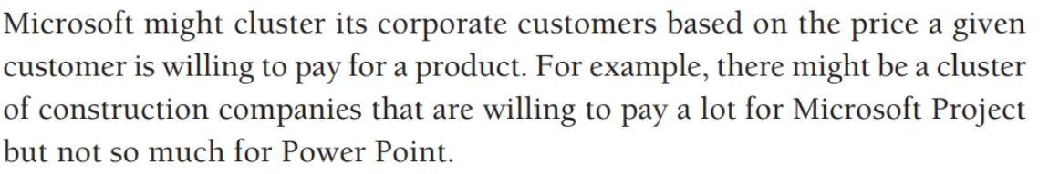
Clustering

Slide 3
Market Segmentation
Market segmentation is the subdividing of a market into distinct subsets of customers.
Segments
Members are different between segments but similar within
Homogeneous
Parsimonious
Accessible
Notes:
2
2

Slide 4
Markets are Dynamic
Segments may be unstable over time
Buyer behavior changes
Competitors change
The business environment changes
Important to view segmentation as
a process to support business decisions
not a static classification of the market

Slide 5
The Many Uses of Segmentation
Short-term:
Sales-force allocation/call planning
Channel assignment
Communication program development: spending, allocation and messaging
Pricing

Slide 6
The Many Uses of Segmentation
Longer term:
Emerging needs (Opportunity-focused segmentation)
New and evolving segments to serve
Planning for segment development/growth and anticipating competitive threats
Notes:
Give example of music industry.

Slide 7
Variables to Describe Markets
Consumer Industrial
Descriptors
Age, income, marital status, Industry, size, location, current Demographics etc. etc.
Psychographics Lifestyle, values, & Personality characteristics of personality characteristics. decision makers.
Behavior Use occasions, usage level, Use occasions, usage level, complementary & complementary & substitute substitute products used, products used, brand loyalty, order brand loyalty, etc. size, applications, etc.
Decision Making Individual or group Formalization of purchasing (family) choice, low or high procedures, size & characteristics involvement purchase, etc. of decision making group, etc.
Media Patterns Level of use, types of Level of use, types of media used, media used, times of use, time of use, patronage at trade shows, etc. receptivity of sales people, etc.
Notes:
8
8

Slide 8
Appropriate Segmentation Bases
General
Brand loyal vs brand switchers
Positioning
Cheapskates vs quality seekers
Pricing: Price sensitivity
Advertising: Media use

Slide 9
Your Examples

Slide 10
Cluster Analysis
Determine business needs
Sourcing, Cleaning & Exploration
Feature Creation (Extract additional information to enrich the set)
Feature Selection (Reduce to a smaller dataset to speed up computation)
Select Customer Segmentation Technique (test and compare some of them)
Apply Selected Customer Segmentation Technique
Analyze results and adjust parameters
Present and explain the results
Notes:
34
34
14

Slide 11
Clustering
Can we find things that are close together?
What does “close” mean?
How to group the “close” things?
How to visualize the results?
How to interpret the results?

Slide 12
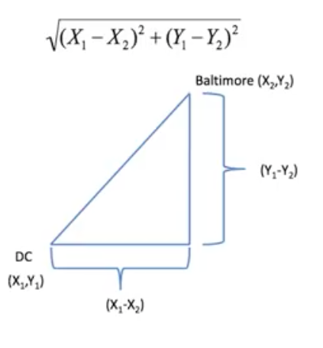
What does “close” mean? Euclidean Distance

Slide 13
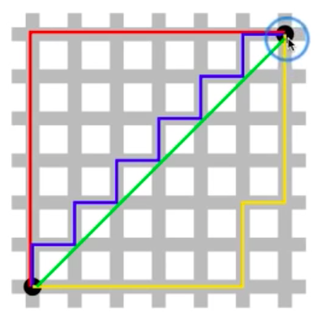
What does “close” mean? Manhattan distance

Slide 14
Clustering
A measure of similarity/distance between segments
Continuous: Euclidean distance
Continuous: Correlation similarity
Discrete: Manhattan distance
What makes sense for your problem?
squares the scores

Slide 15
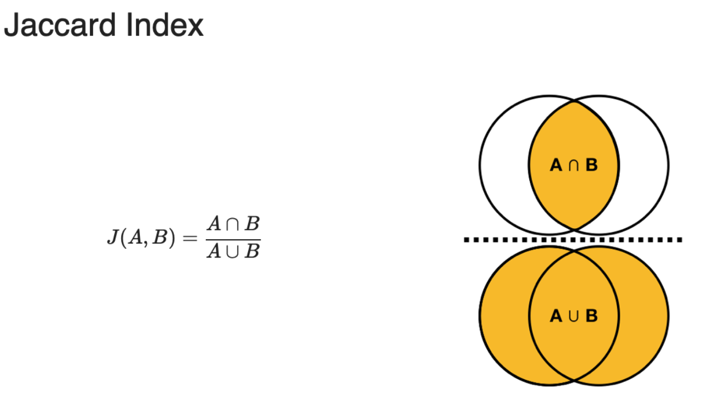
Clustering
A measure of similarity/distance between segments

Slide 16
K-means Clustering
A partitioning approach
Fix a number of clusters
Get “centroids” for each cluster
Assign items to the “closest” cluster
Recalculate “centroids”
Requires
A defined distance matrix
A number of clusters
Initial “centroids”
Produces
Final estimate of “centroids”
Assignment to clusters

Slide 17
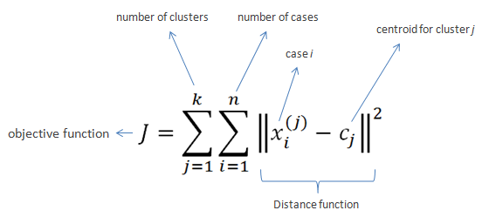
K-means Clustering

Slide 18
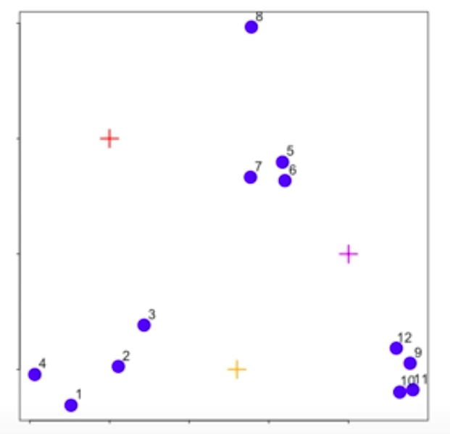
K-means Clustering

Slide 19
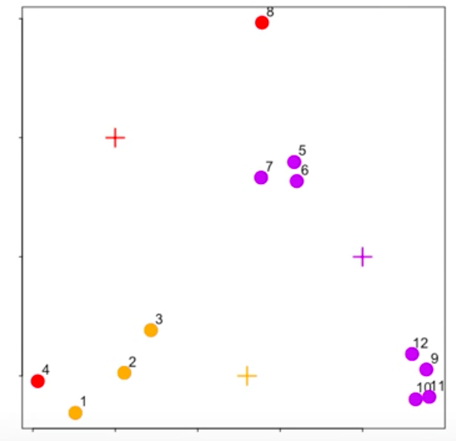
K-means Clustering

Slide 20
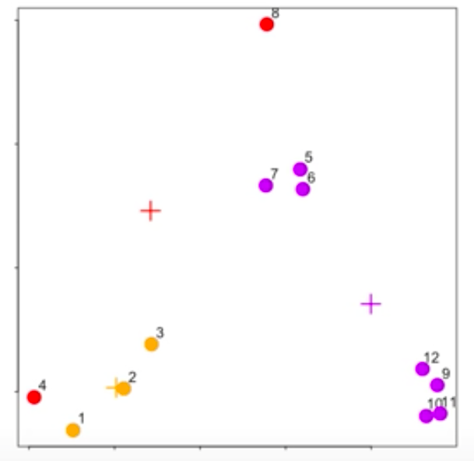
K-means Clustering

Slide 21
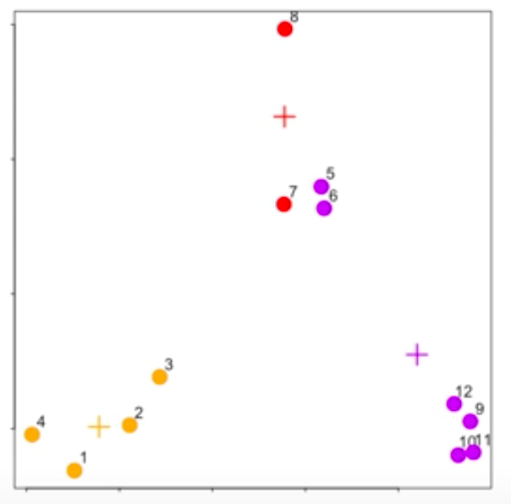
K-means Clustering

Slide 22
Hierarchical Clustering
An agglomerative approach
Put each data point in its own cluster.
Identify closest two clusters & combine them into one.
Repeat above step till all data points are in a single cluster.
Requires
A way to define distance
A way to merge
Produces
A tree showing how close things are to each other

Slide 23
Doing Cluster Analysis
a = distance from member to cluster center
b = distance from I to III
•
•
•
•
•
Dimension 2
III
Perceptions or ratings data from one respondent
b
•
•
•
•
•
•
•
a
I
II
Dimension 1
Notes:
36
36

Slide 24
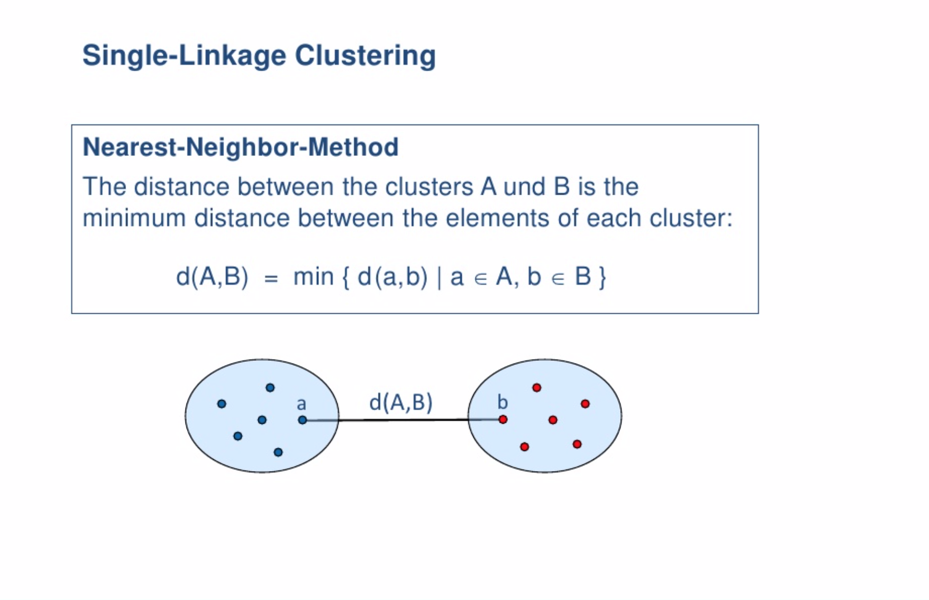
Hierarchical Clustering

Slide 25
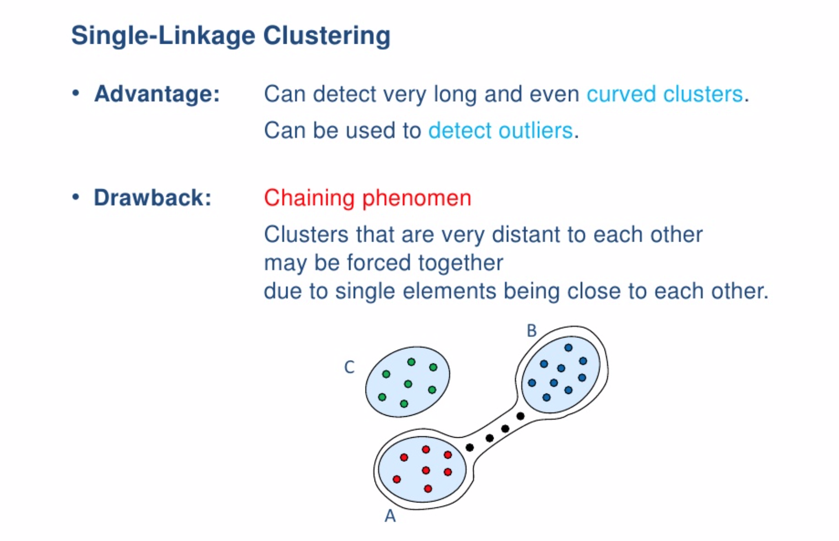
Hierarchical Clustering

Slide 26
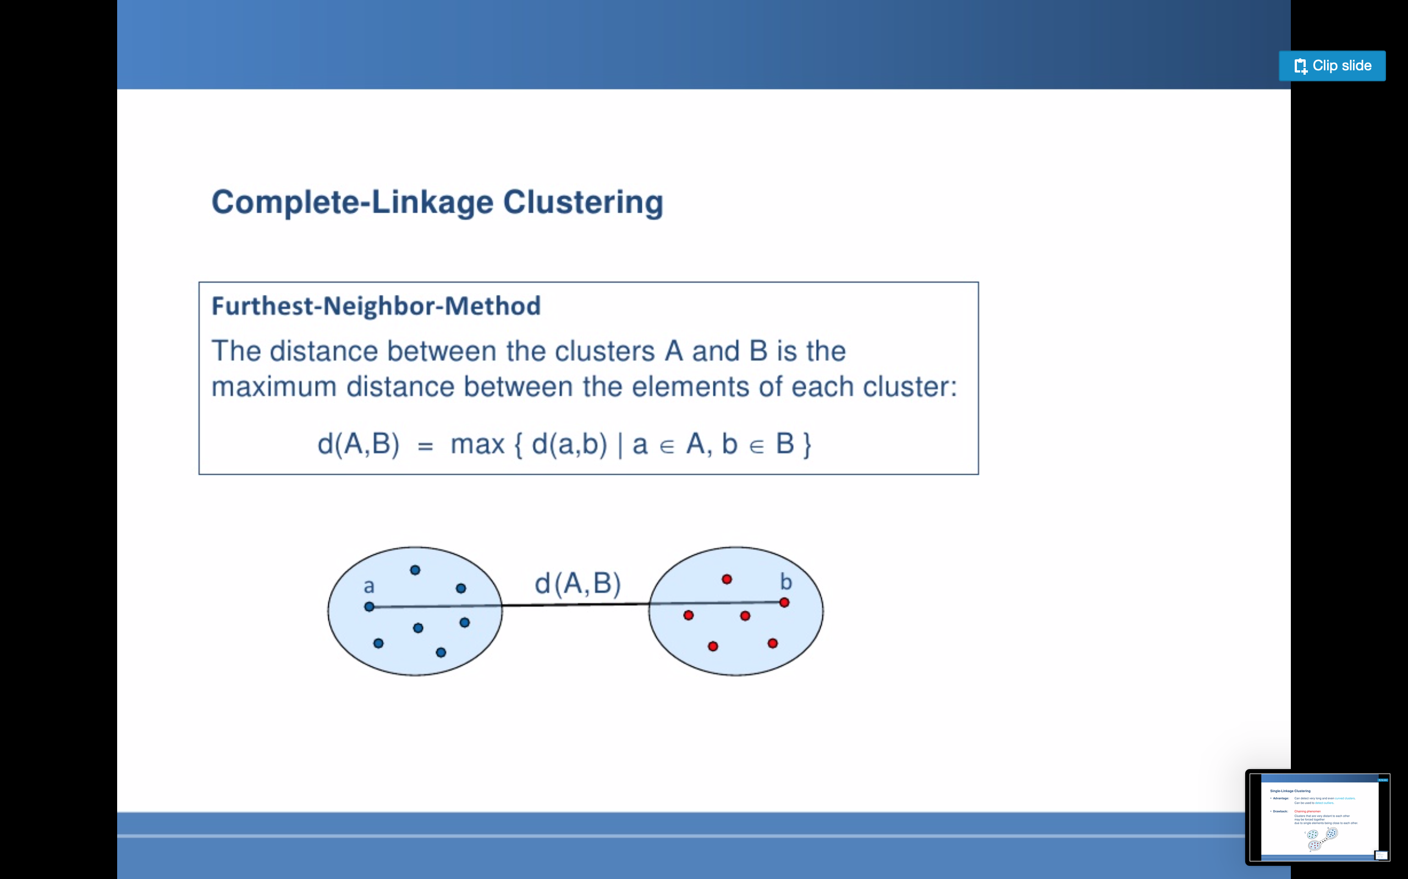
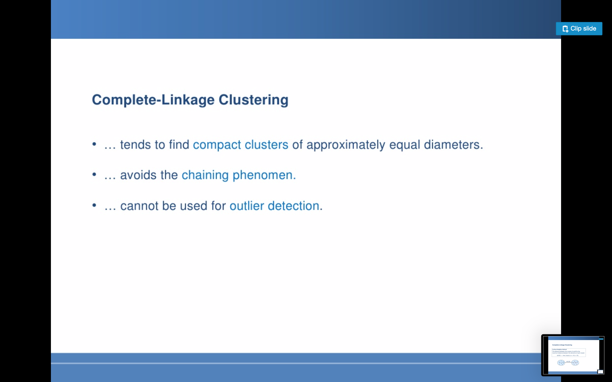
Hierarchical Clustering

Slide 27
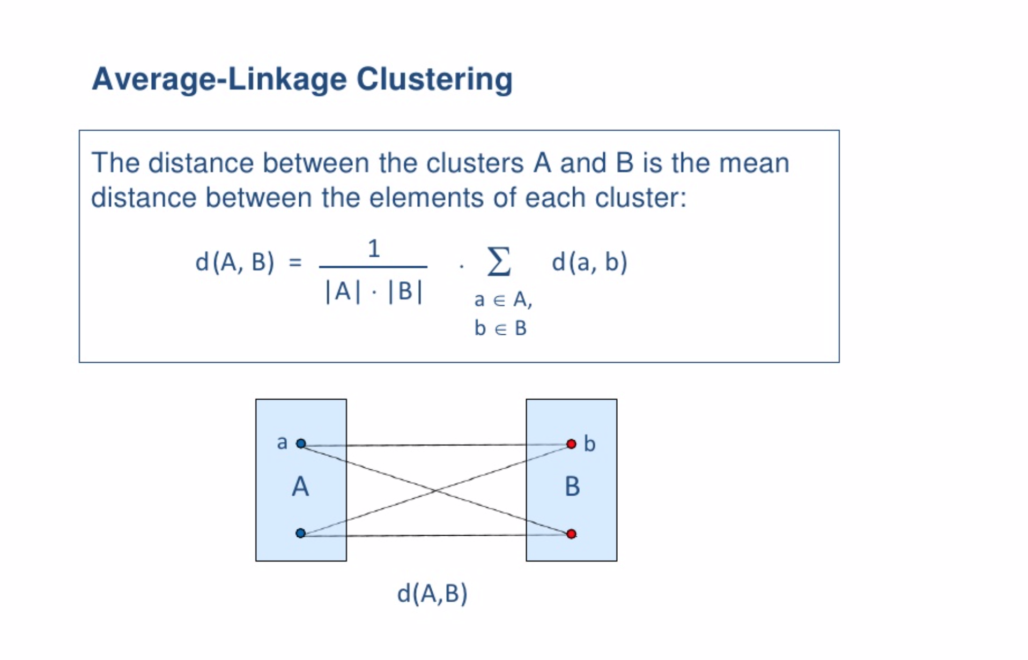
Hierarchical Clustering

Slide 28
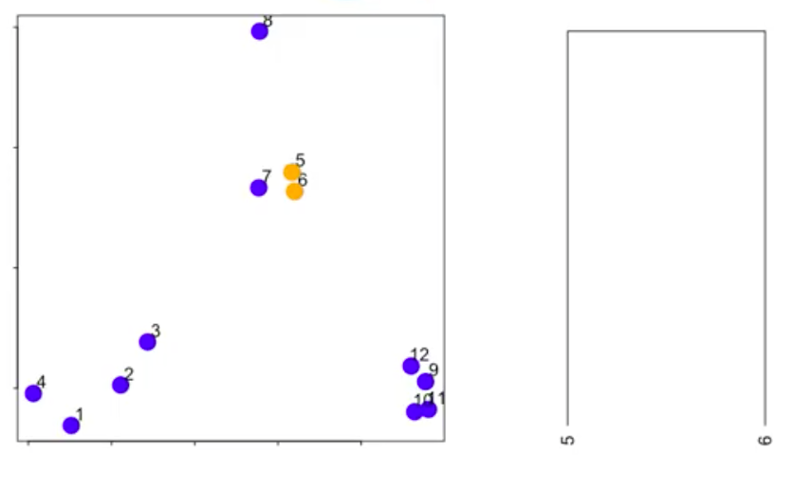
Hierarchical Clustering

Slide 29
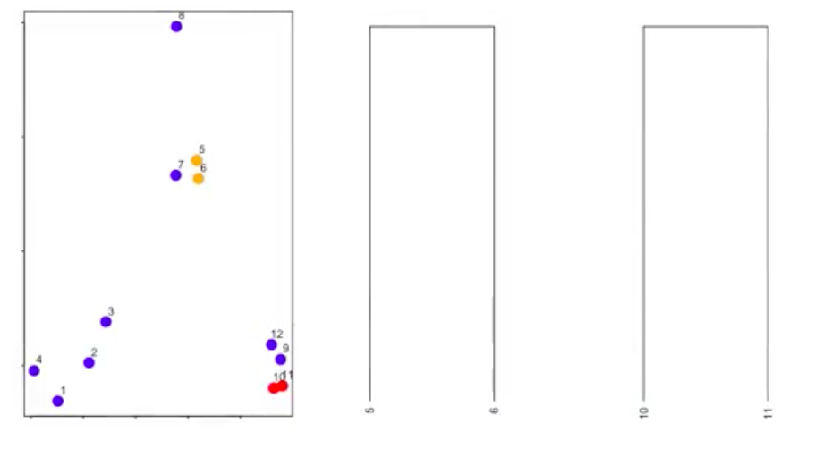
Hierarchical Clustering

Slide 30
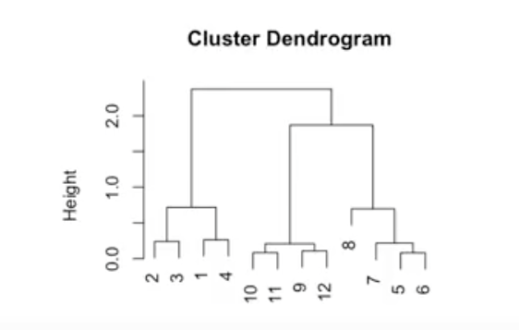
Hierarchical Clustering

Slide 31
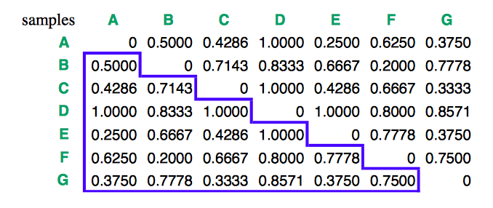
Hierarchical Clustering

Slide 32
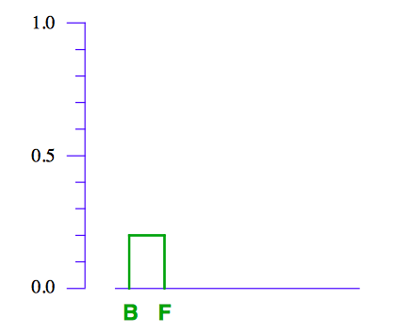
Hierarchical Clustering

Slide 33
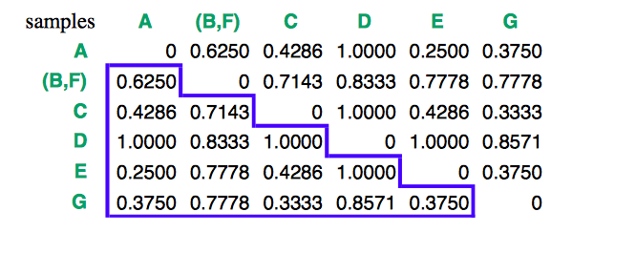
Hierarchical Clustering

Slide 34
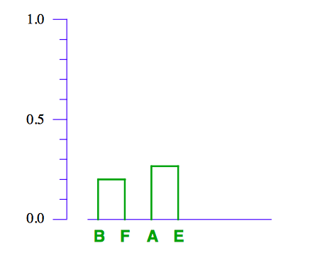
Hierarchical Clustering

Slide 35
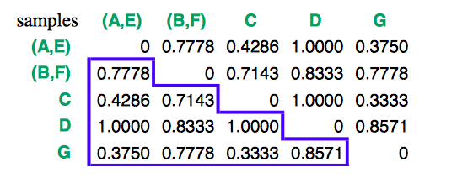
Hierarchical Clustering

Slide 36
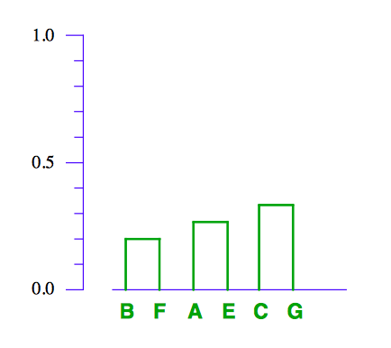
Hierarchical Clustering

Slide 37
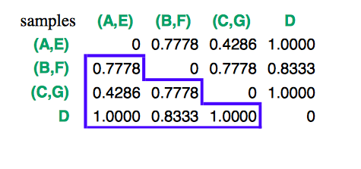
Hierarchical Clustering

Slide 38
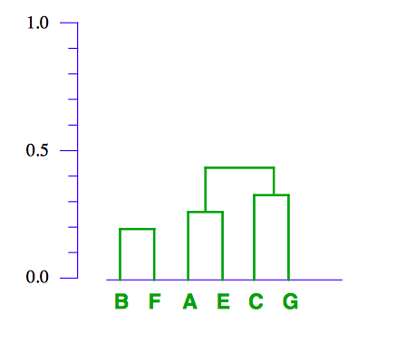
Hierarchical Clustering

Slide 39
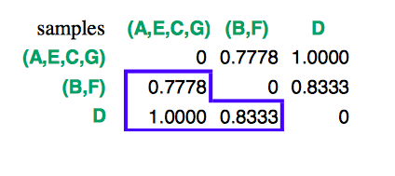
Hierarchical Clustering

Slide 40
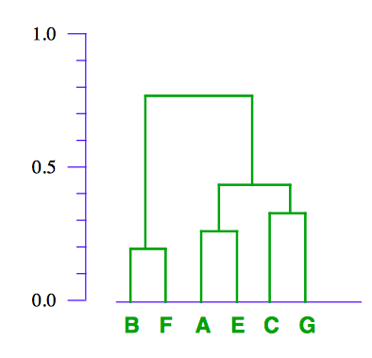
Hierarchical Clustering

Slide 41
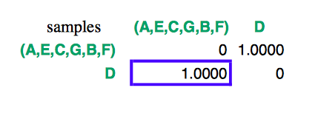
Hierarchical Clustering

Slide 42
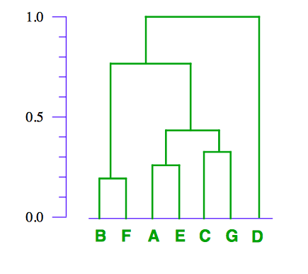
Hierarchical Clustering

Slide 43
How Many Clusters? Elbow Method

Slide 44
How Many Clusters? Elbow Method

Slide 45
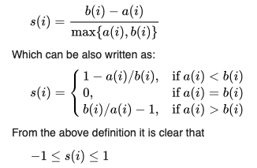
How Many Clusters? Silhouette Analysis

Slide 46
How Many Clusters? Silhouette Analysis

Slide 47
Cluster Analysis: Issues
A measure of similarity/distance between segments
Identify “outliers.”
Select a clustering procedure
Hierarchical clustering
Partitioning methods (e.g., K-Means)
Profile clusters
Univariate analysis
Multiple discriminant analysis
Notes:
35
35

Slide 48
Interpreting Cluster Analysis Results
Select the appropriate number of clusters:
Are the bases variables highly correlated? (Should we reduce the data through factor analysis before clustering?)
Are the clusters separated well from each other?
Should we combine or separate the clusters?
Can you come up with descriptive names for each cluster?
Segment the market independently of your ability to reach the segments (i.e., separately evaluate segmentation and discriminant analysis results).
Notes:
40
40

